Slide 1
Introduction to Microbiome Data Analysis
Composition
Alpha-Diversity
Beta-Diversity
Differential Abundance
Networks
Phylogenetics
Nicholas J. Ollberding, PhD
Associate Professor
Division of Biostatistics and Epidemiology
nicholas.ollberding@cchmc.org

Slide 2

Goals
Provide high-level introduction to methods used in the statistical analysis of microbiome data
Challenging features of microbiome data
Introduce a few common approaches
Work through the Introduction to the Statistical Analysis of Microbiome Data tutorial
https://github.com/Nick243/Introduction-to-Metagenomics-Summer-Workshop-2019
Introduce you to some popular R packages
Work through some example analyses

Slide 3
Conceptual Model of a Microbiome Research Project
P1: Project Planning
P2: Sample Collection
P3: Storage and DNA Extraction
P6: Statistical Analysis
P4: Next-Generation Sequencing
P5: Sequence Read Processing
The “analysis” of microbiome data occurs in 2 steps:
Step 1: processing the raw sequence data into form amenable for statistical analysis (i.e. taxa by sample count matrix)
Step 2: correlating microbial features with outcomes of interest

Slide 4
Challenging Features of Microbiome Data
High dimensional count matrix: p > n
Sparse (many zeros)
Complex correlation structure among taxa
Large differences in total number of reads across samples
Compositional counts are returned:
Total number of reads not directly tied to the starting quantity of DNA
Think of as getting assigned by a random sampling process
Means that values only carry information on the relative abundance of taxa (not absolute info.)
Compositional data invalidate most standard statistical approaches

Slide 5
Accounting for Library Size and Compositional Data
Standardize read counts using external information: spike-in or qPCR
Normalize counts to account for variation in sequencing depths
Calculate “size factor” for each sample as an estimate of standardized library size
Divide the read counts by size factor to produce normalized data
Works well when most taxa are invariant to the condition under study
Simply converting to proportions does not remove compositional constraint
Log-ratio transformation to move from constrained to Euclidian space
Change in coordinate system to remove compositional constraint
Ratio of each taxa relative to some basis on the logarithmic scale
CLR: ratio of each component to geometric mean of all others on log scale
Notes:
Basically two approaches to account for compositional data….
Zymo now has spike-in but for 16S

Slide 6
Alpha-Diversity
Diversity in a single ecosystem or sample
Comprised of:
Richness – number of unique taxa in an environment
Evenness – how evenly taxa are dispersed
Limited ability to estimate these quantities accurately using NGS data:
Richness underestimated due to inexhaustive sampling. Requires extrapolation estimators
Extrapolation estimators require accurate singleton counts which generally cannot be differentiated from sequencing errors

Slide 7
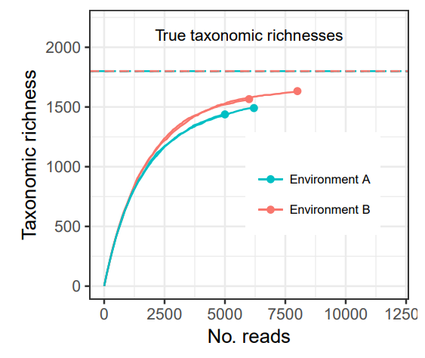
Alpha-Diversity Estimators
Observed richness:
Count of unique taxa
Downwardly biased
Bias is systematic if samples have same
abundance structure
Shannon Diversity:
Summation of prob. x ln(prob.) of observing
each taxon multiplied by -1
Higher number is more diverse environment
Faith’s Phylogenetic Diversity:
Sum of the lengths branches on a phylogenetic tree
Bias systemic if these curves are the same, but this cannot be estimated from the data.
Willis, bioRxiv, 2017.

Slide 8
Beta-Diversity
Whittaker (1960) defined it as “the extent of change in community composition, or degree of community differentiation, in relation to a complex-gradient of environment, or a pattern of environments”
Measure of similarity (or dissimilarity) of one microbial composition to another
Can be based on presence/absence or incorporate abundance
Often used for exploratory analysis of the similarity in microbial assemblages (beta-diversity ordination)

Slide 9
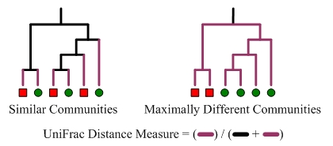
Beta-Diversity Estimators
Bray-Curtis dissimilarity:
Popular dissimilarity metric in ecology
1 – (2 x the lesser count of the intersection of taxa) / total taxa both sites
Values range from 0 to 1
BC = 0 if sites share all the same taxa; BC = 1 if they don’t share any
UniFrac distance:
Popular distance measure in microbial ecology
Uses phylogenic information
Sum unshared branch lengths / sum all branches
Both weighted and unweighted variants
https://www.mothur.org/wiki/Unweighted_UniFrac_algorithm
Notes:
Simple example from: https://www.statisticshowto.datasciencecentral.com/bray-curtis-dissimilarity/
For a simple example, consider two aquariums;
Tank one: 6 goldfish, 7 guppies and 4 rainbow fish,
Tank two: 10 goldfish and 6 rainbow fish.
To calculate Bray-Curtis, let’s first calculate C_{ij} (the sum of only the lesser counts for each species found in both sites). Goldfish are found on both sites; the lesser count is 6. Guppies are only on one site, so they can’t be added in here. Rainbow fish, though, are on both, and the lesser count is 4. So C_{ij} = 6 + 4 = 10.
S_{i} ( total number of specimens counted on site i) = 6 + 7 + 4 = 17, and S_{j} (total number of specimens counted on site j) = 10 + 6 = 16.
So our BC_{ij} = 1 – (2 * 10) / (17 + 16), or 0.39.

Slide 10
Differential Abundance Testing
Common goal of many microbiome studies is to identify specific taxa associated with outcome of interest
Typically performed by testing features one-by-one and applying a false discovery rate correction to control the overall type I error rate
Many challenges associated with attempting to identify specific taxa associated with an outcome
LOTS OF WAYS to do perform these tests
Not clear which approach best for given situtation

Slide 11
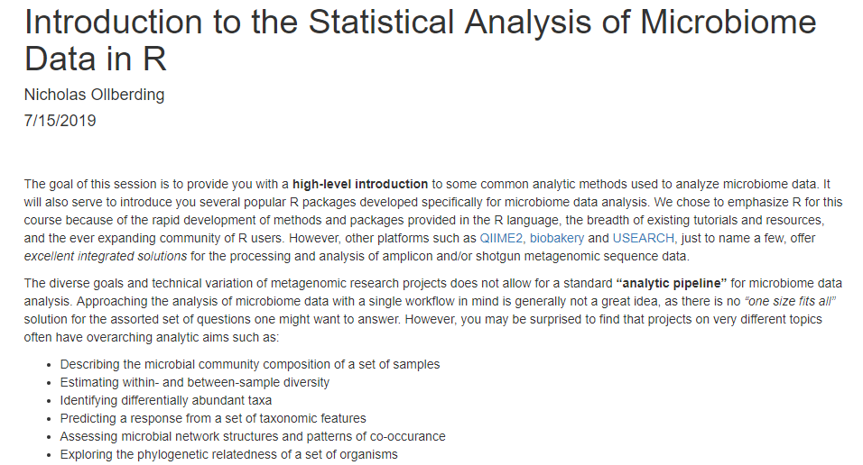
Introduction to Microbiome Analysis Tutorial
https://github.com/Nick243/Introduction-to-Metagenomics-Summer-Workshop-2019

